Slide 1

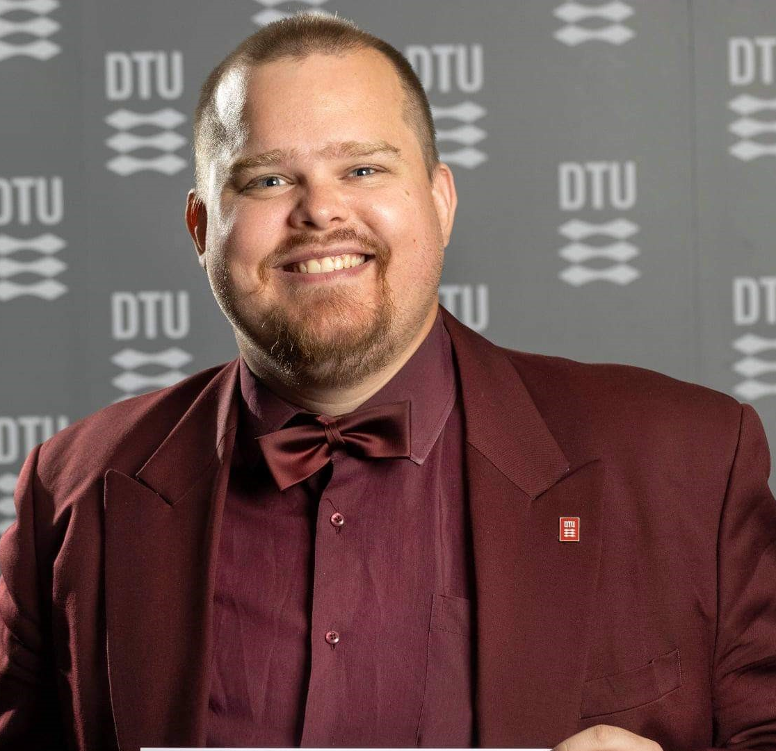







Alexander
Andersen
Consultant at Specialisterne
Professional skills
Education
Biotechnology
Bioinformatics
Data science
System biology
Molecular Biology
Master of Bioinformatics and system biology | 2021
DTU
Specialised in computational biology
Bachelor of Biotechnology
Experience
Languages
Data Management at Specialisterne | 2025
Danish
English
German
French (beginner)
Spanish (beginner)
Russian (beginner)
Who am I?
MySQL-class for python
deep learning promoter prediction
Business analysis In powerBI
ETL-management
TransporterPAL
I am a bio-engineer in the field of computational biology with some years of experience in data science. I have achieved theoretical and practical experience with machine learning and programming and how they can be applied within biotechnology and bioinformatics.
I am good at getting insight into a topic and then generate ideas from it.
IT skills
Personal skills
python
R
Unix
SQL
PowerB
ETL
GitHub
PyMOL
Pytorch
observant
Full of ideas
Insightful
analytical

